Slide 1
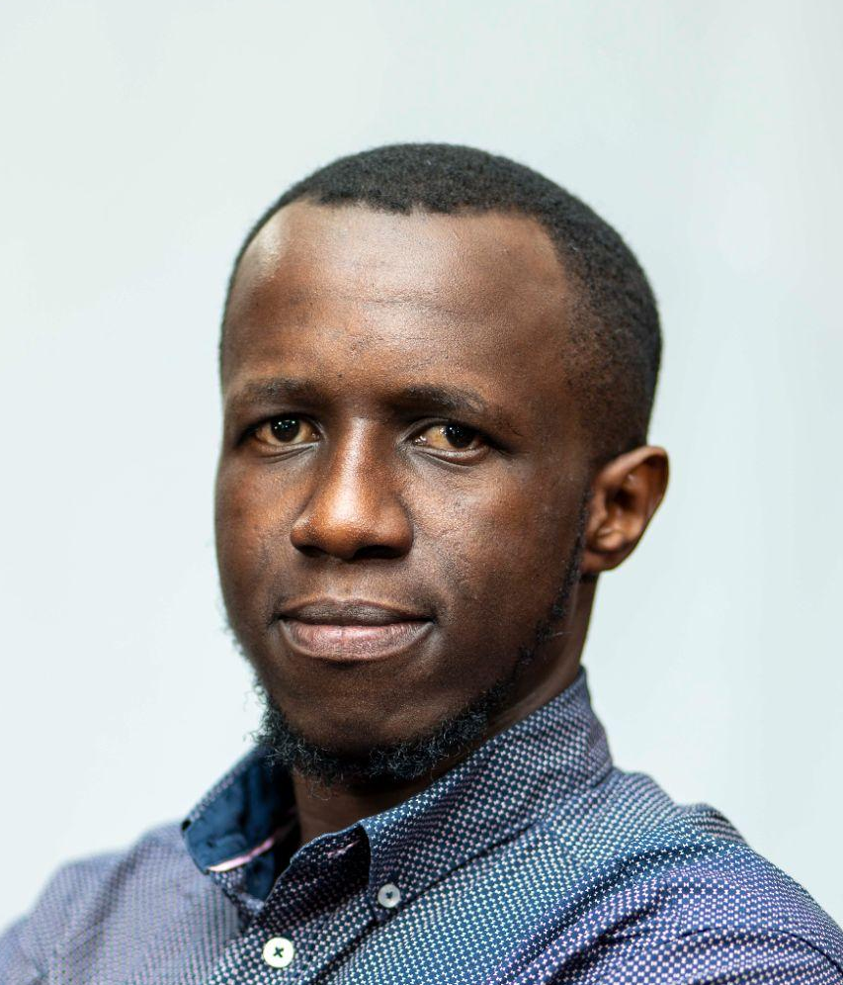

MonitorMed AI
Non-Intrusive Performance Monitoring for FDA-Approved Medical AI
The Challenge
950+ FDA-approved AI medical devices with no performance monitoring
Can't modify validated models
Performance degradation unknown
No traditional MLOps possible
Our Solution: AI model monitoring
92% accurate uncertainty estimation
Zero modification to FDA models
23% reduction in false positives
Target Market
8,000+ Radiology practices in US
950+ FDA-approved AI devices
Jules Udahemuka, CMU
AI/ML Engineer, Healthcare
Abdouh Harouna Kenfack,
AI/ML Engineer

